Slide 1
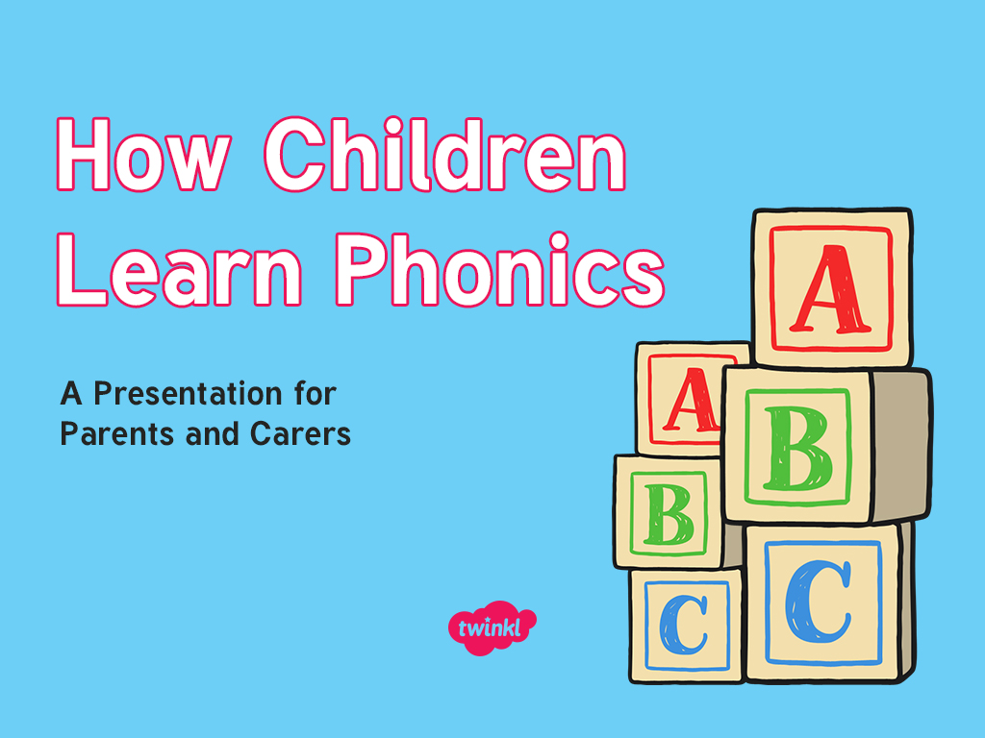



Slide 2

Did You Know…?
The English language has:
26 letters
X
Y
Z
44 sounds
over 100 ways to spell those sounds
It is one of the most complex languages to learn to read and spell.

Slide 3
The Jargon – A Quick Guide
phonics – The teaching of reading by developing awareness of the sounds in words and the corresponding letters used to represent those sounds.
phoneme - Any one of the 44 sounds which make up words in the English language.
grapheme – How a phoneme is written down. There can be more than one way to spell a phoneme. For example, the phoneme ‘ay’ is spelt differently in each of the words ‘way’, ‘make’, ‘fail’, ‘great’, ‘sleigh’ and ‘lady’.
blending – Putting together the sounds in a word in order to read it, e.g. ‘c - a- t, cat’ Help by blending some sounds together to help your child identify the word ‘ca - t’. Do this visually with letters far apart then together.
segmenting – Breaking a word into its constituent sounds in order to spell them, e.g. ‘dog, d – o – g’’ We stretch a word to help hear its sounds and use our robot arms
tricky words - words that cannot be decoded using phonics
phonetically plausible –written phonetically so that it can still be read although it is spelt incorrectly
Notes:
It can be interesting to see how many ways there are to spell other sounds – try ‘igh’, ‘ee’ or ‘ow’.
A fun way to learn blending with young children is to talk to them in segmented words, for example ‘Please g – e – t’ the ‘m – i – l – k’ out of the ‘f – r – i – dge’.
When children begin to segment to spell they will often use the wrong spelling of phonemes, for example ‘I luv yoo’ or ‘Migh naym is…’. This is not a problem, as the key skill at this stage is that they can hear the sounds in the words and have a go at writing them down.

Slide 4
What Is Phonics?
Phonics is a method for teaching reading and writing.
It develops phonemic awareness – the ability to hear, recognise and use the sounds within words.
Learners are also taught to match the sounds and the graphemes (individual letters or spelling patterns) that represent them.
Phonics is currently the main way in which children in British primary schools are taught to read in their earliest years.
Children will also be taught other skills, such as whole-word recognition (see ‘tricky words’), book skills and a love and enjoyment of reading.
Notes:
Typically, children begin to develop the listening skills essential to phonics in their preschool years. Some children begin to learn letter sounds at preschool but most children will begin their main phonics learning once they start their reception year at primary school (age 4-5). This teaching continues through year 1 (age 5-6) and into year 2 (age 6-7) until the child is a confident and fluent reader.
Once children are fluent readers, the emphasis in reading teaching moves more towards comprehension and analysis skills.
Book skills include holding books correctly, turning pages right to left, recognising that print represents words, talking about pictures, retelling familiar stories, asking and answering questions about stories and non-fiction texts and treating books with respect.

Slide 5
Why Are Children Taught Phonics?
Phonics, taught in a structured way, is generally accepted to be the most effective way to teach reading and writing.
Children learn to hear and recognise sounds in words and spell them correctly.
This assists with their confidence, accuracy and fluency.
Phonics should not be taught in isolation — children also need to learn other reading and comprehension skills alongside phonic knowledge. So Wrens all also have have library books to foster a love of reading and to develop their comprehension skills.

Slide 6
Letters and Sounds
We use Twinkl phonics at Semley school with the Jolly phonics actions and songs which many of our Wrens older siblings will be familiar with. Do look on Wrens class page on the school website for the Jolly Phonics actions shet.
Twinkl Phonics is based on Letters and Sounds was a resource for the teaching of phonics which was issued by the Department for Education in 2007.
It is divided into six sections, or phases, intended to begin in the preschool years and finish at the end of year 2 (age 7).
Notes:
See class page on website for JP actions.

Slide 7
Phase One
Phase 1 has seven aspects, with a focus on listening skills.
1: Environmental sounds
2: Instrumental sounds
3: Body percussion
4: Rhythm and rhyme
5: Alliteration
6: Voice sounds
7: Oral blending and segmenting
Notes:
Environmental sounds – sounds we hear around us every day; listening to and imitating sounds; how to be a good listener. Ideas – make sounds to copy, e.g. sh sh sh, zzzzzz, p-p-p-p; go on a ‘listening walk’ – what can you hear?; talk about how to be a good listener; sing songs that require repetition and response, e.g. ‘Old MacDonald’.
Instrumental sounds – listening to and discriminating the sounds made by different instruments. Ideas – make sounds with a range of different instruments (non-musical instruments such as pots, pans, home-made shakers will all do); play an echo game where children have to copy a rhythm; hide an instrument behind a box or screen and play it, children have to say which instrument you are playing.
Body percussion – using the body to create sounds and follow a song, rhyme or beat. Ideas – sing songs that require actions, such as ‘Wind the Bobbin Up’, ‘Heads, Shoulders, Knees and Toes’, ‘If You’re Happy and You Know It, Clap Your Hands’; pass a body percussion sound around a group, e.g. sit in a circle or opposite one another, take turns to produce a body percussion sound which is then passed on, e.g. tap on shoulders, clap hands, stamp feet.
Rhythm and rhyme – recognising rhythms and rhymes in songs, speech and nursery rhymes. Ideas – sing and chant rhyming songs; read stories with repetition and rhyme, e.g. ‘The Gingerbread Man’, ‘Each Peach Pear Plum’; play a matching game with pictures of rhyming objects, e.g. frog/dog, hat/cat, mouse/house; clap the rhythm of phrases and rhymes or the syllables in words or names; play ‘I Spy’ – ‘I spy, with my little eye, something that rhymes with….’ Example game on next slide.

Slide 8


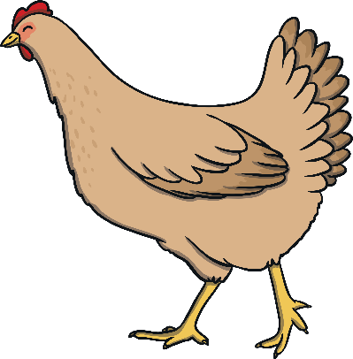

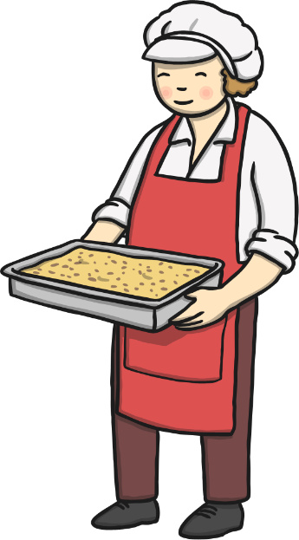




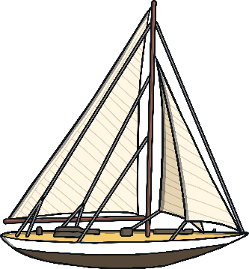
Find the Rhymes

Slide 9

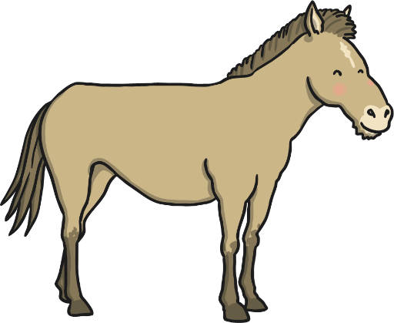
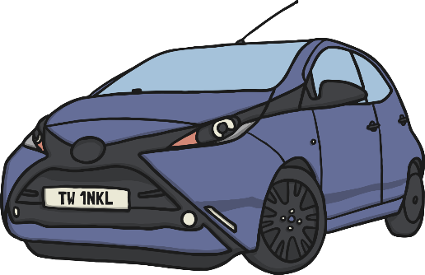




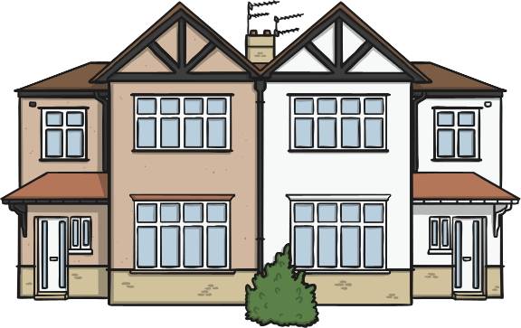
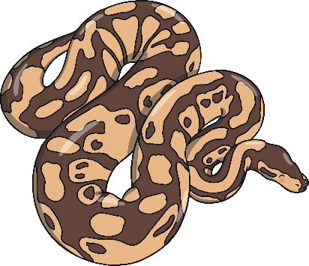
Find the Starting Sounds
Can you find three things beginning with ‘sss’?
How many things begin with ‘h’?
Notes:
Set 1: s, a, t, p
Set 2: i, n, m, d
Set 3: g, o, c, k
Set 4: ck, e, u, r
Set 5: h, b, f, ff, l, ll, ss
Phase 2 usually begins when children start their formal education in reception, though some preschools may also begin to teach letter sounds

Slide 10
Phase Two
In Phase 2, children begin to learn some letter sounds and to match them to graphemes.
Most of the first sounds are single-letter sounds but there are also several digraphs, where one sound is represented by two letters, e.g. ‘ck’, ‘ll’, ‘ss’. They usually occur at the end or in the middle of words.
Children also begin to blend the sounds to make words. By the end of Phase 2, children will be able to read some ‘vowel-consonant’ (vc) at, in is, and ‘consonant-vowel-consonant’ (cvc) words, e.g. cat, pin.
Five sets of letters are introduced – one set per week THese are all on the treasury tag strings in your child’s book bag
Children will also learn to read the ‘tricky’ words the, to, go, I, no, which cannot be read phonetically. These are the words in the small pouches in your child’s book bag
Notes:
Set 1: s, a, t, p
Set 2: i, n, m, d
Set 3: g, o, c, k
Set 4: ck, e, u, r
Set 5: h, b, f, ff, l, ll, ss
Phase 2 usually begins when children start their formal education in reception, though some preschools may also begin to teach letter sounds.

Slide 11
Phase Two
In Phase 2, children begin to learn some letter sounds and to match them to graphemes.
One of the most important ways to help your child learn phonics and begin to read is to support them with pronouncing their letter sounds and blends of letters correctly. If you click on the video ‘How to pronounce letter sounds correctly’ on the EYFS section of the school website, it will demonstrate how we say each letter sound. Essentially do not add ‘uh’ at the end of each letter sound!
Notes:
Set 1: s, a, t, p
Set 2: i, n, m, d
Set 3: g, o, c, k
Set 4: ck, e, u, r
Set 5: h, b, f, ff, l, ll, ss
Phase 2 usually begins when children start their formal education in reception, though some preschools may also begin to teach letter sounds.

Slide 12

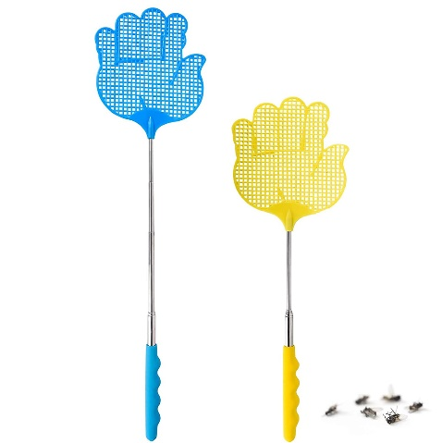
Phase 2 games to play with sound cards
Grapheme recognition
Remove cards from string and spread them out face up on the floor. Can your child find/jump on/fly swat the letter/grapheme to match the sound you say?
Instead of saying the sound give your child several words, e.g. egg, elephant, extra so they have to identify the initial sound to know the grapheme they are looking for.
If they get stuck on a sound say ‘warmer’ if they move nearer it and ‘colder’ if they are moving away from it.

Slide 13

Teaching Phonics in School
Children are taught reading and spelling daily throughout the week, and each session will follow a structured format.
The activities used to teach will vary and can be adapted. They are multisensory and appeal to different learning styles. They involve games and individual and group activities as well as teacher-led sessions.
Teachers will assess children’s understanding throughout each session and will also assess knowledge of sounds to see whether a child is ready to move on to the next phase.
Notes:
Assessment at the end of a phase will usually involve asking children to name sounds to check that they know all of the Phase 2 sounds before they move on to Phase 3. Teachers may also assess ability to blend sounds to read words.

Slide 14
Phase Three
Phase 3 usually lasts around 12 weeks. Children are taught another 25 graphemes.
The final single-letter sounds are taught, together with more consonant digraphs (e.g. zz, qu) and several vowel digraphs (e.g. ai, ee, igh).
Children also continue to learn how to blend and segment CVC words using the new sounds, e.g. tail, sheet, night – note that these words still only have three sounds.
Children will then move on to blending and segmenting two-syllable words such as cooker, eating, broken.
Tricky words also continue to be taught.
Notes:
Set 6: j, v, w, x
Set 7: y, z, zz, qu
Consonant digraphs: ch, sh, th, ng
Vowel digraphs: ai, ee, igh, oa, oo, ar, or, ur, ow, oi, ear, air, ure, er

Slide 15
Phase Four
By Phase 4, children are able to represent each of 42 phonemes with a grapheme. Children will be able to read CVC words and begin to segment them to spell them.
Phase 4 is consolidation of children’s knowledge. Children also move on to blending and segmenting using adjacent consonants, e.g. st, sp, tr, br, spr, str in words such as string, blow, train.
Phonics teaching continues to be regular and structured and children play games to consolidate their learning.
Notes:
Set 6: j, v, w, x
Set 7: y, z, zz, qu
Consonant digraphs: ch, sh, th, ng
Vowel digraphs: ai, ee, igh, oa, oo, ar, or, ur, ow, oi, ear, air, ure, er

Slide 16
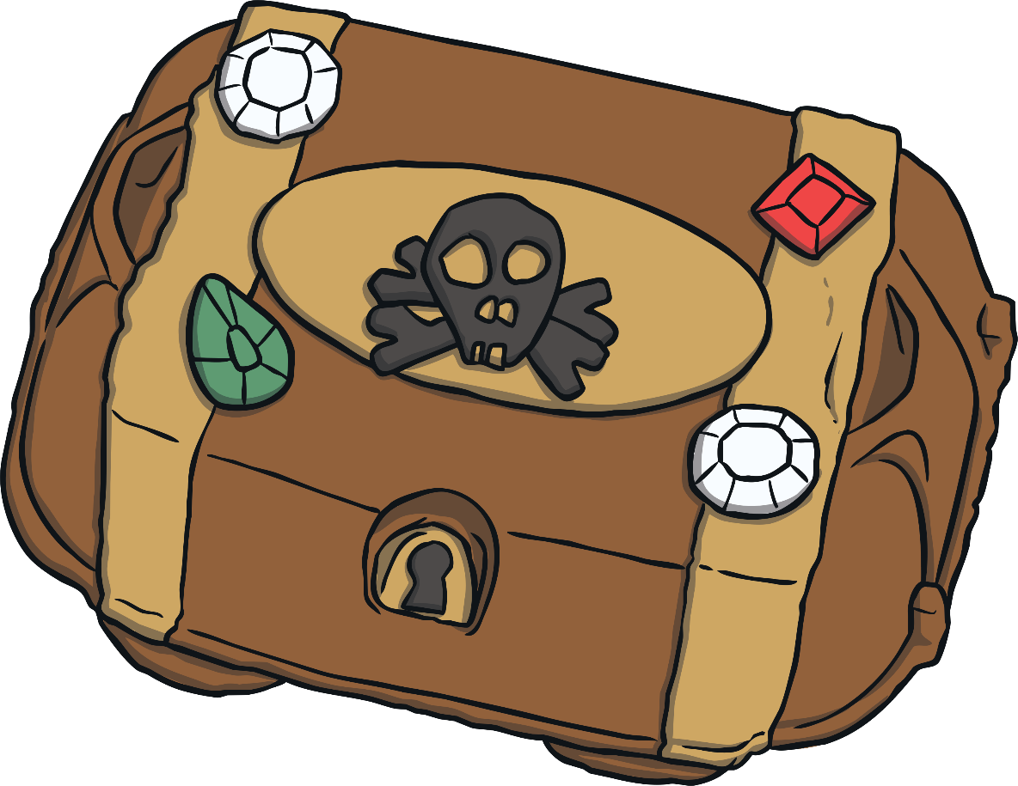
Buried Treasure
What have the pirates hidden in the chest?

Slide 17





brick

Slide 18



Yes or No?
Can a clock clap hands?
Can a spoon grab a fork?
Do trains run on tracks?

Slide 19
Phase Five
Children will broaden their knowledge of graphemes and phonemes.
They will learn alternative ways of spelling the phonemes they have already learnt.
They will learn strategies to help them choose the correct grapheme for spelling.
Children will be reading with more and more fluency, no longer needing to ‘sound out’ most familiar words.
Notes:
Children will be taught new graphemes and alternative graphemes for the sounds they already know. They will begin to learn to choose the appropriate grapheme when spelling. The children will be automatically decoding a large number of words for reading by this point.

Slide 20
The Year 1 Phonics Check
In June, all year 1 children are expected to complete the year 1 phonics screening check.
The aim is to check that a child is making progress in phonics. They are expected to read a mixture of real words and ‘nonsense’ words.
If a child has not reached the expected standard, schools must give additional support to help the child to make progress in year 2.
Notes:
Pupils who have achieved the expected standard at the end of year 1 will have experience of decoding all of the types of words that appear in the year 1 phonics screening check. They will know the correct grapheme to go with most sounds and be able to blend phonemes in words in the screening check.
‘Nonsense’ words or ‘alien’ words are designed to test pure phonic ability rather than knowledge of words. Examples might include ‘baf’, ‘gip’, ‘leet’, ‘stoof’.
For more information about the format of the phonics check, see Twinkl’s ‘Year 1 Phonics Screening Check’ Powerpoint.

Slide 21
Phase Six and Beyond
Phase 6 is mainly taught as children progress through year 2 (age 6-7).
Children are becoming fluent readers and more accurate spellers. They learn more spelling patterns such as the use of prefixes and suffixes, contracted forms of words (e.g. can’t, won’t) and other words in common usage such as days of the week.
At this stage, children can read hundreds of words automatically. They are now reading for pleasure and reading to learn rather than learning to read.
They can decode words quickly and silently and only need to sound out longer or more unfamiliar words.
Notes:
In Phase 6, children will be reading longer and less familiar texts independently and fluently. It is crucial that, at this point, children are now reading to learn and reading for pleasure.
Children should be able to read the 300 high-frequency words. At this point, it is important that comprehension strategies are developed so that children clarify meaning, ask and answer questions about the texts that they are reading, construct mental images during reading and summarise what they have read.
In spelling, children are introduced to the adding of suffixes and how to spell longer words. Throughout the phase, children are encouraged to develop strategies for learning spellings.

Slide 22
Helping Your Child at Home
Work on listening skills, go on a sound walk. Play memory games e.g. I went to market and I bought….
Practise segmenting (for spelling) and blending (for reading) . Take turns to robot speak a word!
Look for familiar sounds and words in the world around you, particularly tricky words.
Revise Phase 2 and 3 sounds by using the activity sheets on the school website (Key information- Curriculum - English) for any sounds your child finds tricky to remember.
Practise new sounds and graphemes. Show your child how to make the new sound with your mouth and practise it in a mirror. Go on a sound hunt around the house (Set a time limit!) , highlight a given sound in a newspaper. Can they think of 6 words with that sound in?
Read to and with your child every day.

Slide 23


